Slide 1
COMP 2100
Week 2 - Friday

Slide 2
Last time
What did we talk about last time?
Java Collections Framework (JCF)
Computational complexity
Big Oh notation

Slide 3
Assignment 1

Slide 4
Assignment 2

Slide 5
Project 1

Slide 6
Questions?

Slide 7
Back to complexity

Slide 8
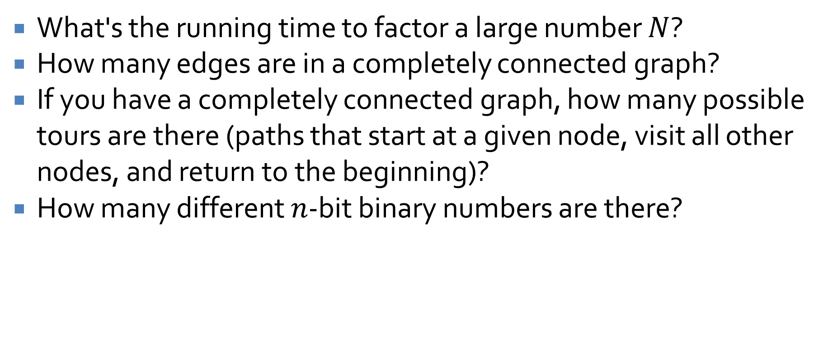
Mathematical issues
What's the running time to factor a large number $N$?
How many edges are in a completely connected graph?
If you have a completely connected graph, how many possible tours are there (paths that start at a given node, visit all other nodes, and return to the beginning)?
How many different $n$-bit binary numbers are there?

Slide 9
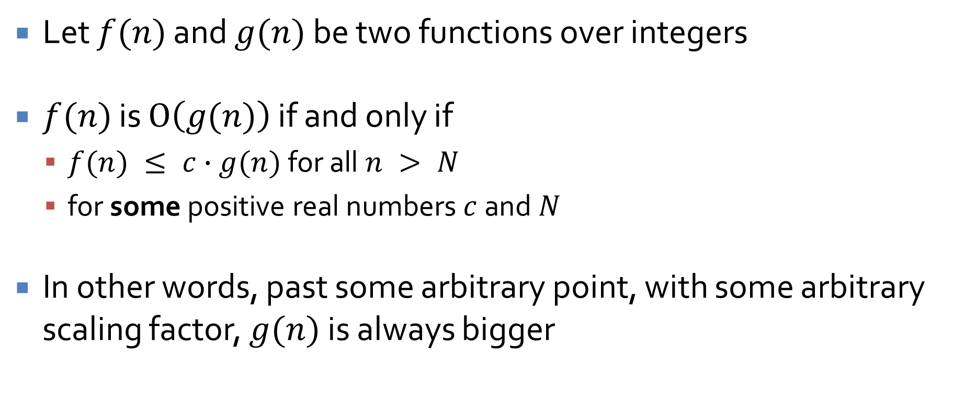
Formal definition of Big Oh
Let $f(n)$ and $g(n)$ be two functions over integers
$f(n)$ is $O\left(g(n)\right)$ if and only if
  $f(n) ≤ c∙g(n)$ for all $n > N$
  for some positive real numbers $c$ and $N$
In other words, past some arbitrary point, with some arbitrary scaling factor, $g(n)$ is always bigger

Slide 10
What's the running time?
int count = 0;
for (int i = 0; i < n; i += 2) {
for (int j = 0; j < n; j += 3) {
++count;
}
}

Slide 11
What's the running time?
int count = 0;
for (int i = 0; i < n; ++i) {
for (int j = 0; j < n; ++j) {
if (j == n - 1) {
i = n;
}
++count;
}
}

Slide 12
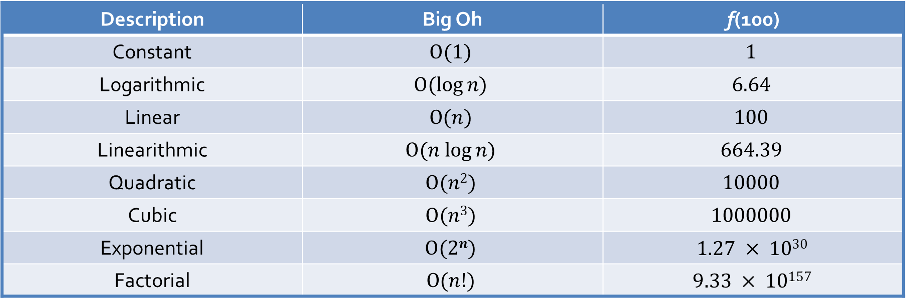
Hierarchy of complexities
Here is a table of several different complexity measures, in ascending order, with their functions evaluated at n = 100
Description | Big Oh | f(100)
Constant | $$O(1)$$ | $$1$$
Logarithmic | $$O(log⁡n)$$ | $$6.64$$
Linear | $$O(n)$$ | $$100$$
Linearithmic | $$O(n log⁡n)$$ | $$664.39$$
Quadratic | $$O(n2)$$ | $$10000$$
Cubic | $$O(n3)$$ | $$1000000$$
Exponential | $$O(2n)$$ | $$1.27 × 1030$$
Factorial | $$O(n!)$$ | $$9.33 × 10157$$

Slide 13
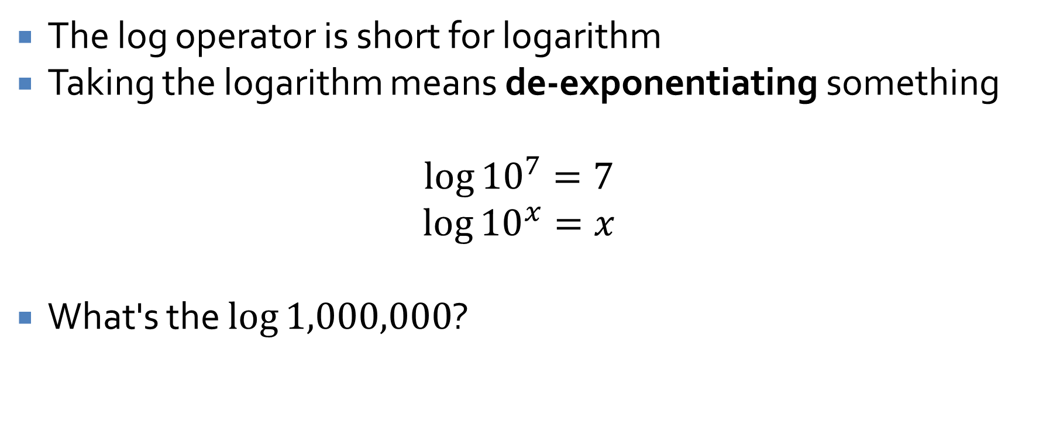
What's log?
The log operator is short for logarithm
Taking the logarithm means de-exponentiating something
$$\log{{10}^{7}=7}$$
$$\log{{10}^{x}=x}$$
What's the $log⁡1,000,000$?

Slide 14
What's the running time?
int count = 0;
for (int i = 1; i <= n; i *= 2) {
++count;
}

Slide 15
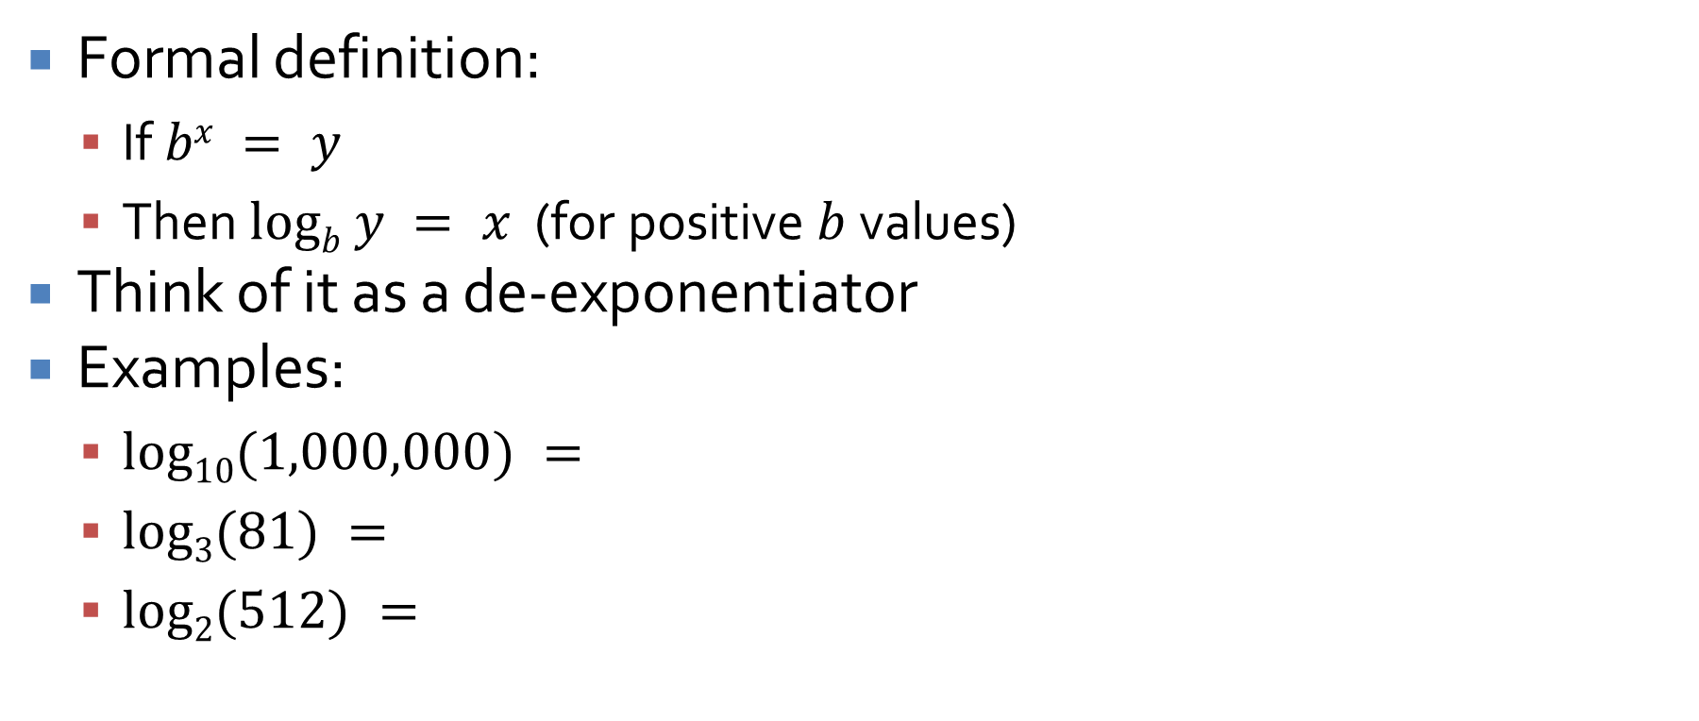
Logarithms
Formal definition:
  If $bx = y$
  Then $logb y = x$ (for positive $b$ values)
Think of it as a de-exponentiator
Examples:
  $log10(1,000,000) =$
  $log3(81) =$
  $log2(512) =$

Slide 16
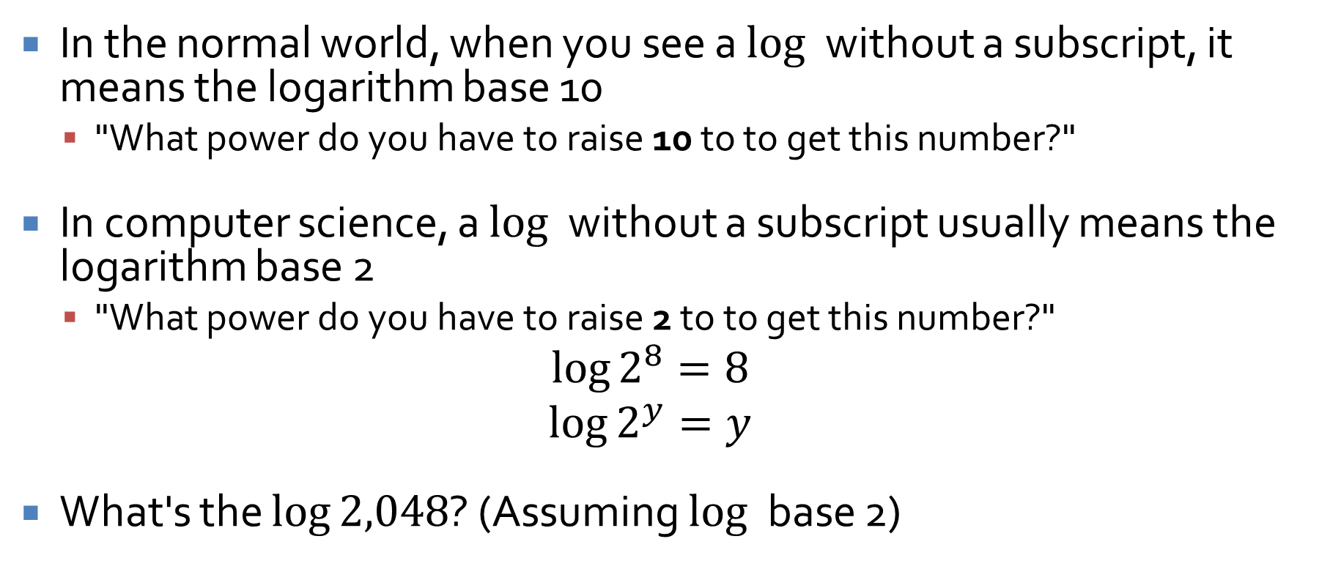

$log$ base 2
In the normal world, when you see a $log⁡$ without a subscript, it means the logarithm base 10
  "What power do you have to raise 10 to to get this number?"
In computer science, a $log⁡$ without a subscript usually means the logarithm base 2
  "What power do you have to raise 2 to to get this number?"
$$\log{2^{8}=8}$$
$$\log{2^{y}=y}$$
What's the $log⁡2,048$? (Assuming $log⁡$ base 2)

Slide 17
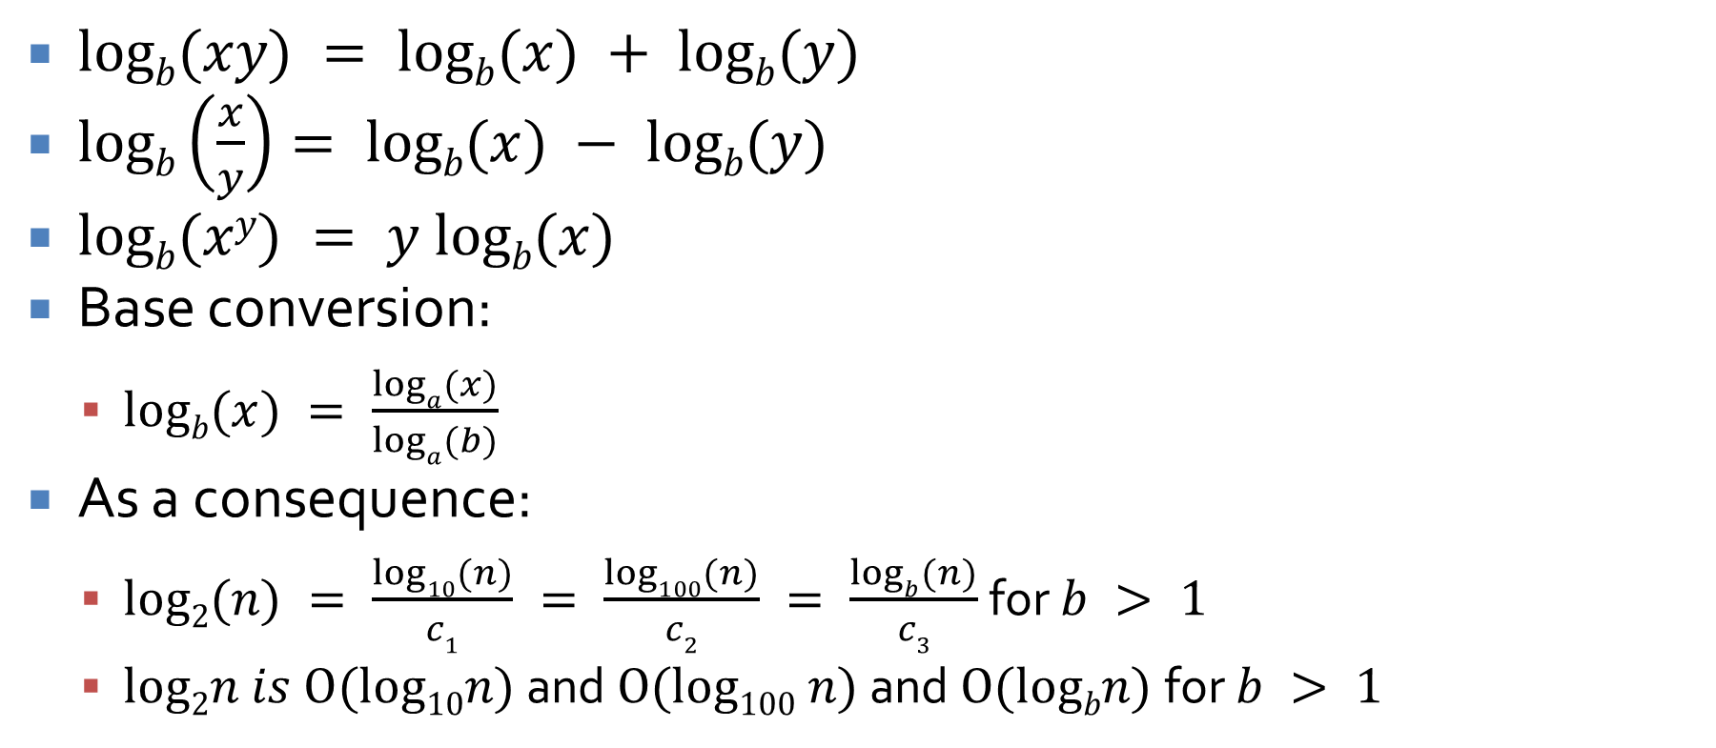

$log⁡$ math
$logb(xy) = logb(x) + logb(y)$
$logb\left(\frac{x}{y}\right)= logb(x) − logb(y)$
$logb(xy) = y logb(x)$
Base conversion:
  $logb(x) = \frac{loga(x)}{loga(b)}$
As a consequence:
  $log2(n) = \frac{log10(n)}{c1} = \frac{log100(n)}{c2} = \frac{logb(n)}{c3}$ for $b > 1$
  $log2n is O(log10n)$ and $O(log100 n)$ and $O(logbn)$for $b > 1$

Slide 18
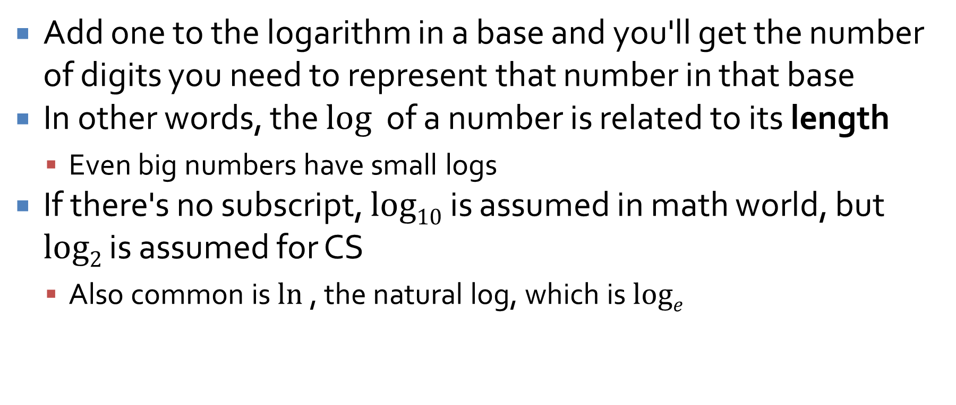

More on $log⁡$
Add one to the logarithm in a base and you'll get the number of digits you need to represent that number in that base
In other words, the $log⁡$ of a number is related to its length
  Even big numbers have small logs
If there's no subscript, $log10$ is assumed in math world, but $log2$ is assumed for CS
  Also common is $ln⁡$, the natural log, which is $loge$

Slide 19
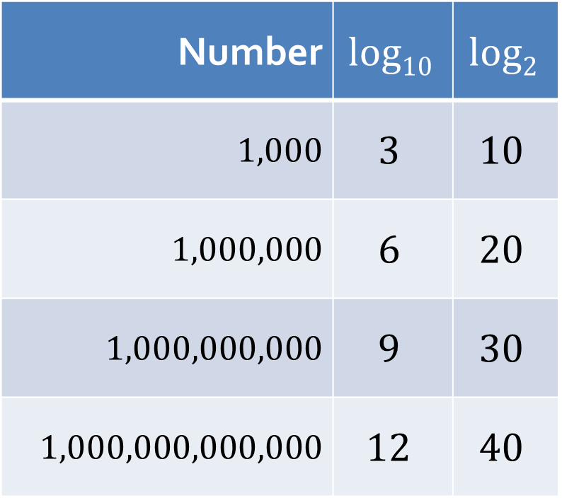
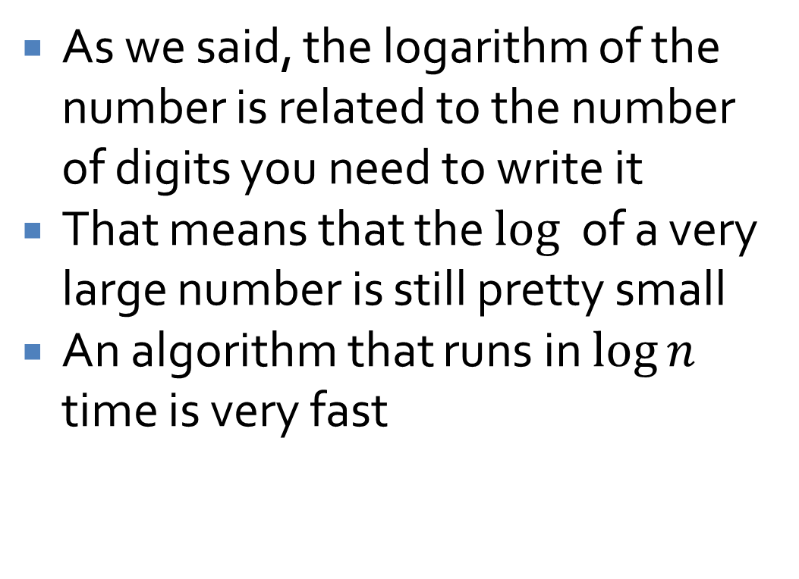
Log is awesome
As we said, the logarithm of the number is related to the number of digits you need to write it
That means that the $log⁡$ of a very large number is still pretty small
An algorithm that runs in $log⁡n$ time is very fast
Number | $$log10$$ | $$log2$$
$$1,000$$ | $$3$$ | $$10$$
$$1,000,000$$ | $$6$$ | $$20$$
$$1,000,000,000$$ | $$9$$ | $$30$$
$$1,000,000,000,000$$ | $$12$$ | $$40$$

Slide 20
Big Oh, Big Omega, Big Theta

Slide 21
Formal definition of Big Oh
Let $f(n)$ and $g(n)$ be two functions over integers
$f(n)$ is $O\left(g(n)\right)$ if and only if
  $f(n) ≤ c∙g(n)$ for all $n > N$
  for some positive real numbers $c$ and $N$
In other words, past some arbitrary point, with some arbitrary scaling factor, $g(n)$ is always bigger

Slide 22
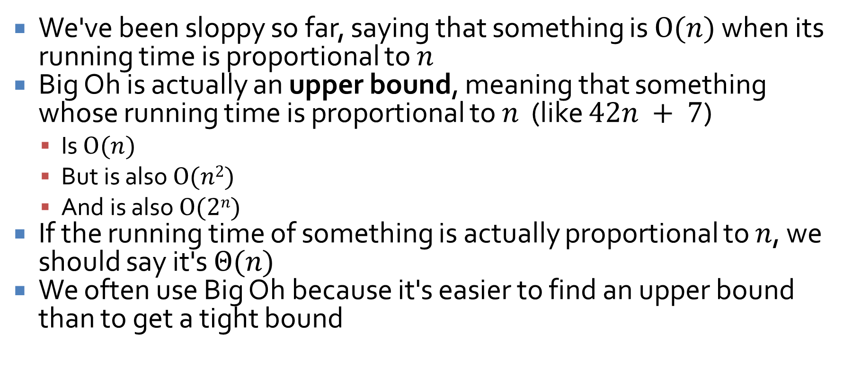
Different kinds of bounds
We've been sloppy so far, saying that something is $O(n)$ when its running time is proportional to $n$
Big Oh is actually an upper bound, meaning that something whose running time is proportional to $n$ (like $42n + 7$)
  Is $O(n)$
  But is also $O(n2)$
  And is also $O(2n)$
If the running time of something is actually proportional to $n$, we should say it's $Θ(n)$
We often use Big Oh because it's easier to find an upper bound than to get a tight bound

Slide 23
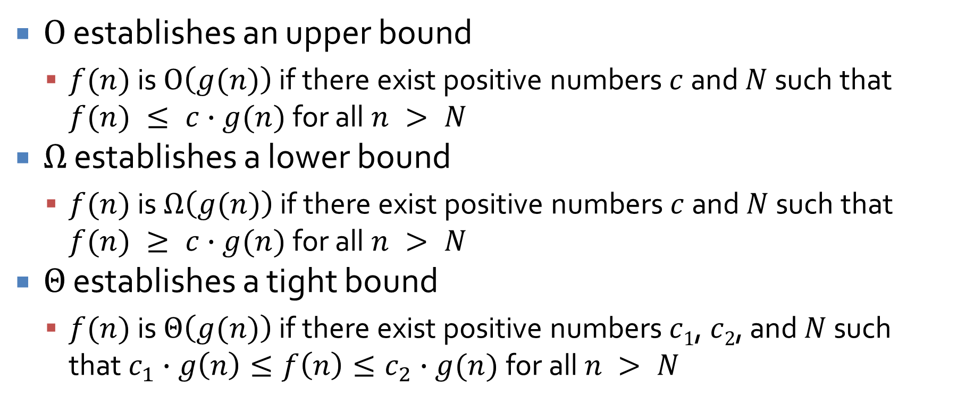
All three are useful measures
$O$ establishes an upper bound
  $f(n)$ is $O\left(g(n)\right)$ if there exist positive numbers $c$ and $N$ such that $f(n) ≤ c∙g(n)$ for all $n > N$
$Ω$ establishes a lower bound
  $f(n)$ is $Ω\left(g(n)\right)$ if there exist positive numbers $c$ and $N$ such that $f(n) ≥ c∙g(n)$ for all $n > N$
$Θ$ establishes a tight bound
  $f(n)$ is $Θ\left(g(n)\right)$ if there exist positive numbers$c1$, $c2$, and $N$ such that $c_{1}∙g\left(n\right)≤f\left(n\right)≤c_{2}∙g(n)$for all $n > N$

Slide 24
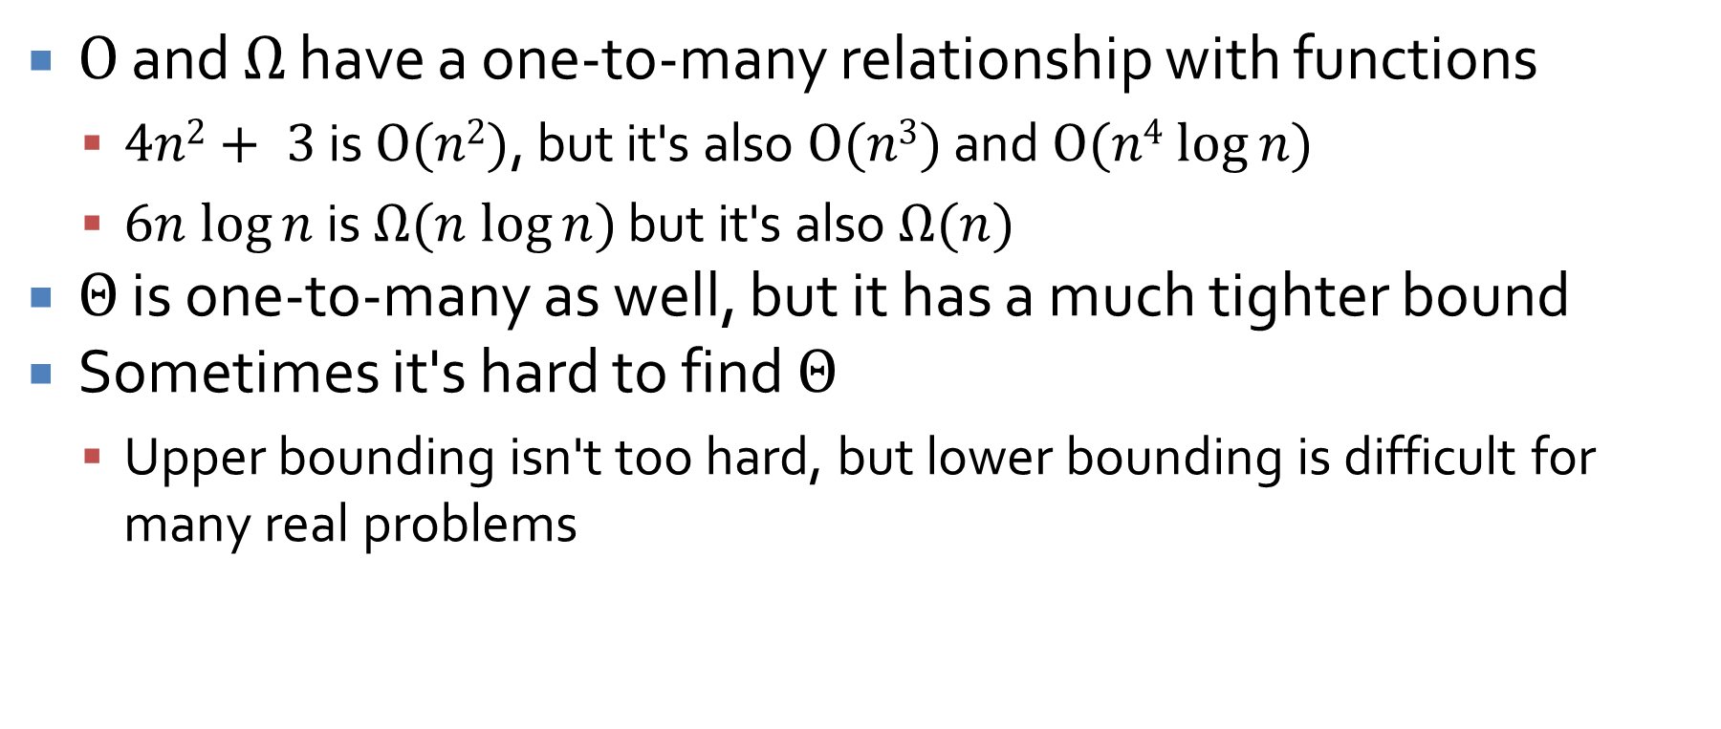
Tight bounds
$O$ and $Ω$ have a one-to-many relationship with functions
  $4n2+ 3$ is $O(n2)$, but it's also $O(n3)$ and $O(n4 log⁡n)$
  $6n log⁡n$ is $Ω(n log⁡n)$ but it's also $Ω(n)$
$Θ$ is one-to-many as well, but it has a much tighter bound
Sometimes it's hard to find $Θ$
  Upper bounding isn't too hard, but lower bounding is difficult for many real problems

Slide 25
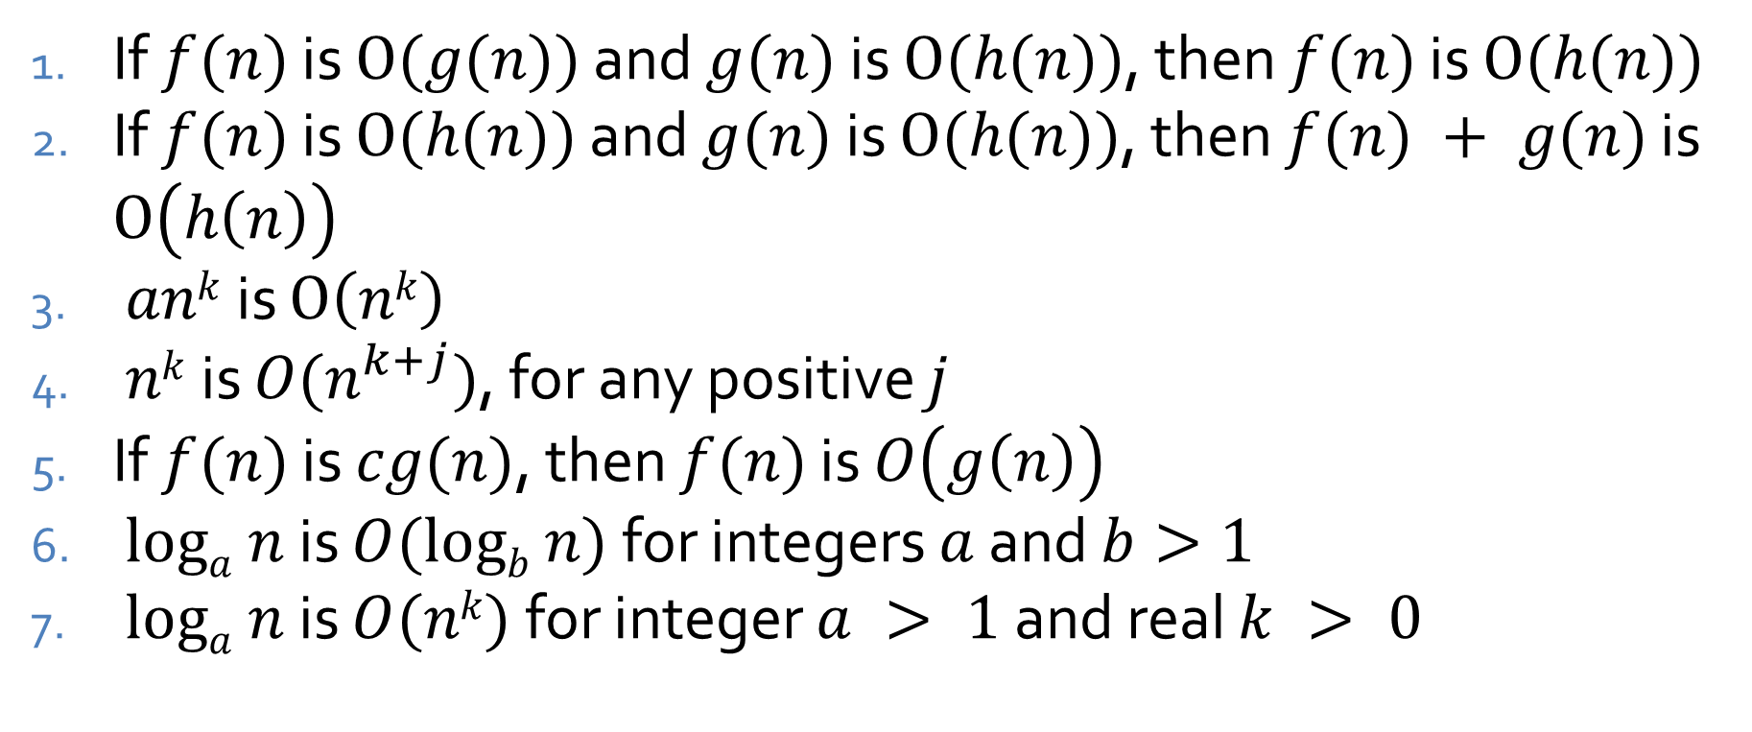
Facts
If $f(n)$ is $O(g(n))$ and $g(n)$ is $O(h(n))$, then $f(n)$ is $O(h(n))$
If $f(n)$ is $O(h(n))$ and $g(n)$ is $O(h(n))$, then $f(n) + g(n)$ is $O\left(h\left(n\right)\right)$
$ank$ is $O\left(nk\right)$
$nk$ is $O(n^{k+j})$, for any positive $j$
If $f(n)$ is $cg(n)$, then $f(n)$ is $O\left(g\left(n\right)\right)$
$loga n$ is $O(logb n)$ for integers $a$ and $b>1$
$loga n$ is $O(nk)$ for integer $a > 1$and real $k > 0$

Slide 26
Binary search example
Implement binary search
How much time does a binary search take at most?
What about at least?
What about on average, assuming that the value is in the list?

Slide 27

Complexity practice
Give a tight bound for $n^{1.1} + n log⁡n$
Give a tight bound for $2^{n+a}$ where $a$ is a constant
Give functions $f1$ and $f2$ such that $f1(n)$ and $f2(n)$ are $O(g(n))$ but $f1(n)$ is not $O(f2(n))$

Slide 28
Upcoming

Slide 29
Next time…
Abstract data types (ADTs)
Bags and ArrayList

Slide 30
Reminders
No class Monday!
Read section 1.3
Finish Assignment 1
  Due tonight by midnight!
Start Assignment 2
  Due next Friday by midnight
Keep working on Project 1
  Due Friday, September 12 by midnight

